Slide 1

Furama – Gen AI Chatbot Assistant
SoftwareOne Team
September 2024

Slide 2

Our Understanding of Your Requirements

Slide 3

SoftwareOne Understanding
Requirements
Use Case
Furama aims to enhance user experience by replacing its existing chatbot with a more advanced chatbot assistant powered by Generative AI (Gen AI). The goal of this project is to develop a customer-facing chatbot that can effectively handle common inquiries related to hotel bookings, such as whether breakfast is included. The chatbot will utilize AWS technology to leverage advanced natural language processing capabilities, allowing it to generate contextually relevant responses based on propriety data and integrate to get information from the Reservation Management System (RMS)
Phase 1: The chatbot will initially focus on answering simple questions by utilizing a knowledge base built from the company's website QA, internal documents etc. This phase aims to reduce the workload on customer service agents by automating responses to frequently asked questions.
Phase 2: The chatbot will be integrated with the RMS, enabling it to access to booking data and provide more detailed answers, such as checking specific booking details etc.
3

Slide 4
Existing Challenges
Requirements
Without the use of Large Language Models (LLMs) or generative AI, the chatbot lacks the ability to tailor responses based on individual user preferences or past interactions, resulting in a generic user experience.
The current system may not effectively integrate with internal data sources such as the (RMS), limiting the chatbot's ability to provide information on room availability, pricing, and other relevant data.

Slide 5
Technical Requirements
Requirements
Data Ingestion: A system for uploading and maintaining accurate information from various sources, including website content and other internal QA.
User Interface : A user-friendly interface that allows customers to interact easily with the chatbot on the website. The new chatbot should be deployed on the customer website.
Integration with RMS: Development of a mechanism to connect the chatbot with the four different RMS sources for data access.
Feedback Mechanism: The chatbot should also provide a feedback option a thumbs up/down to end user in order to give the LLM to learn and self train itself.

Slide 6

Our Approach & Solution

Slide 7





Approach
Step 1
Step 2
Step 3
Step 4
Step 5
Kickoff & Discovery
Foundation Setup
Workload Build
Testing
Deployment
Conduct discovery sessions with customer to understand the data sources that needs to be ingested into knowledge base
In-Depth Analysis of integration points such RMS and other systems (if any)
Infrastructure requirements and dependencies
Establish the foundational infrastructure by provisioning resources, networking and security best practices using AWS console.
Set up basic cloud monitoring and reporting mechanisms.
Implement ingestion of data into the knowledge repository.
Implement frontend interface for the chatbot
Implement end to end RAG workflow with integration with PMS system.
Perform functional and integration testing for the Gen AI Chatbot
Support customer in UAT to validate that the deployed solution meets business requirements.
Final rollout of the chatbot ensuring all components are fully operational and accessible to users.
Deploy the chatbot to Furama Website.
Gen AI Powered Furama Chatbot
7

Slide 8
Proposed Solution
Approach & Solution
To address the pain points identified by Furama , we propose a comprehensive solution leveraging automation & AWS Cloud with the following key features:
Phase 1
Data Ingestion: Load documents into a knowledge base.
Identify and gather source documents (e.g., PDFs, HTML files) that contain relevant information.
Store the processed documents in an Amazon S3 bucket.
Knowledge Base: Store and manage data for retrieval.
Set up Amazon OpenSearch Service Serverless as your vector database to store embeddings of the documents.
Utilize an AWS Bedrock to read documents from S3, chunk them into manageable pieces, and convert these chunks into embeddings using Embeddings models.
Retrieval Mechanism: Retrieve relevant information based on user queries.
When a user submits a query, convert it into an embedding using the same Titan Embeddings model used for document chunking.
Perform a similarity search in vector database to find the most relevant document chunks based on the query embedding.
Combine the retrieved chunks with the original user query to create a comprehensive prompt for the generative model.
Frontend Application: Provide a user interface for interaction.
Develop a frontend application using React that allows users to input queries and display responses from the assistant.
Integrate with backend services AWS Lambda that handle query submissions and responses from the generative model.
Phase 2
Conversation Memory: Store conversation history for context.
Use Amazon DynamoDB to store conversation memory, including user queries, assistant responses, and relevant context.
Implement session management to track ongoing conversations and retrieve previous interactions when needed.
Agent Workflow: Integration with Furama backend system
Develop an agent that can securely connect to the hotel’s PMS to retrieve relevant information. implement robust authentication and authorization mechanisms to ensure secure access to the PMS system from the agent.
Augment the retrieval mechanism with agent workflow

Slide 9
Solution Architecture

Slide 10
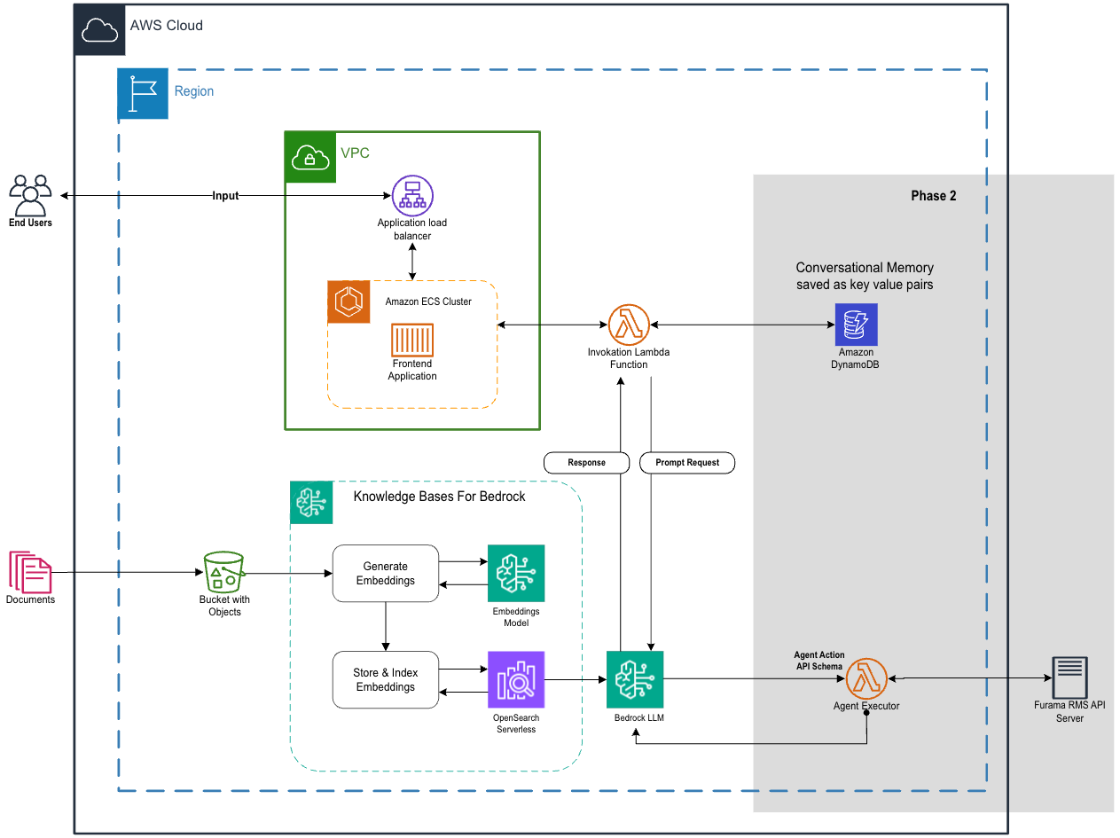
10
Notes:
Data Foundations
Advisory Services
Energise your organisation's data prowess, driving toward data-fuelled decisions. We empower you to harness the full spectrum of your data's potential.
Improve data ecosystem maturity
Envision and align your data strategy
Migration and modernisation assessments
Platform Services
Elevate your capabilities with a robust data foundation, ensuring streamlined processing and insights at your fingertips. Through modern platforms, seamless migrations, and optimised data operations, we weave technology with strategy to supercharge your data proficiency.
Migrate legacy systems to advanced cloud environments
Streamline and accelerate data operations
Align governance for compliance and productivity
Solutions Services
Dive deep into your data, unveiling the stories it tells to enhance decision-making and optimise performance. Through engaging visualisations, systematic business intelligence, and insightful analytics, we transform raw data into your competitive edge.
Craft interactive visual reports from raw data
Mine business intelligence for process optimisation
Understand past trends to guide future decisions
Analytics and AI
Advisory Services
Unleash AI's transformative power, aiming for tangible business wins. We introduce AI's vast capabilities, assess your current state, and co-create solutions that resonate with your aspirations.
Envision and align your AI strategy
Generate analytics and AI use cases
Platform Services
Enable the power of advanced analytics in your organisation, driving innovation with leading platforms and processes. Through specialised data science platforms, streamlined model operations, and adoption of generative AI, we propel you to the forefront of the AI revolution.
Design innovative solutions
Launch ready-to-use infrastructure and templates for data science projects
Efficiently manage and scale machine learning models
Tap into the potential of generative AI with industry-leading platforms
Solutions Services
Unearth profound insights from your data, propelling your organisation into a future where decisions are precise, responses are immediate, and complexities simplified. Our suite of accelerators employs cutting-edge analytics and AI, crafting a roadmap where predictions guide decisions and automation becomes second nature.
Predict future trends and drive actions with targeted recommendations
Gain instantaneous insights from ever-changing data
Craft AI models that continually adapt and improve, emulating human thought

Slide 11
Pilot Scope
Approach & Solution
Deep dive discovery with stakeholders to analyze documents that needs to be ingested into the knowledge base gen ai powered chatbot assistant.
Develop a frontend chatbot interface that users will use to ask contextual information.
Develop a RAG workflow that queries the LLM and augments it with data from knowledge base to generate user response.
Integrate the chatbot with Furama Reservation Management Systems.
Integrate the chatbot with Furama existing website.
Functional and User Acceptance Testing.
Documentation and Training for Gen AI Chatbot

Slide 12
Pilot Deliverables
Approach & Solution
Gen AI Powered Chatbot deployed on Furama Website.

Slide 13
Pilot Assumptions
Approach & Solution
Sufficient historical data exists for training the chatbot effectively, including FAQs and typical customer inquiries.
Furama team and SoftwareOne to work to together on integrating the chatbot to their website.
2 AWS accounts will be provisioned for building the chatbot - DEV and PROD.
All work will be performed remotely using a hybrid delivery model that combines onshore and offshore resources.
All documents will be provided in English.

Slide 14
Exclusions & Dependencies
Approach & Solution
Exclusions:
Landing Zone Implementation.
Adding custom chunking strategies that are not provided by AWS Bedrock.
Integrating with generative AI models not supported by AWS Bedrock.
Any item not defined in scope is considered out of scope.
Dependencies:
Stakeholders availability for discovery workshops, training and user acceptance testing
Communication of Security clearance for provisioning of infrastructure resources.

Slide 15
Tenataive Project Timeline - Pilot
Approach & Solution
MILESTONES
TIMELINE
W1
Month1
W2
W3
W4
1
Project Kick Off & Discovery
2
Knowledge Base Creation
3
Frontend Development
4
RAG Workflow
5
Functional Testing
6
User Acceptance Test
7
Production Deployment
8
Sign-off & Warranty

Slide 16
Project Team Structure
Approach & Solution
Project Team
PROJECT LEADERSHIP
STEERING COMMITTEE
Project Sponsor
SWO Executive Sponsor
SWO Key Account Customer Success Manager
Engagement Executive
SWO Delivery Head
Project Manager
SWO Project Manager
Project Team
Project Manager (Singapore)
Solution Architect(Singapore)
Data Engineer
(Offshore)
Software Engineer
(Offshore)
SoftwareONE
Furama

Slide 17

Commercials

Slide 18
Professional Services
Commercials
Phase | Description | One Time Professional Services (USD)
1. | PHASE 1 | $29,252
2. | PHASE 2 | $16,000
 | TOTAL PRICING | $45,252
All costs exclude GST

Slide 19
Thank You

